Slide 1


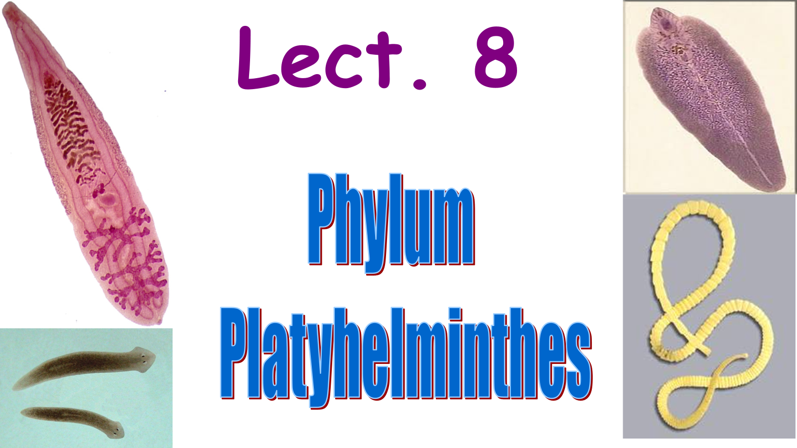
BASRAH UNIVERSITY
Faculty of Education for Pure Sciences
Biology Department
2025- 2026
Presented By: Prof. Dr. Sabeeh H. AL-Mayah

Slide 2
Characteristics of Phylum Platyhelminthes (“flat worm”)
Flatworms have three germ layers (triploblastic); they are the first animal we have discussed in this class with true organs and tissues.
Bilateral symmetry and cephalization.
Flatworms are acoelomate, which means the spaces between the organs are filled with mesoderm tissue called parenchyma.
Many flatworms like the turbellarians are free-living (meaning non-parasitic and not attached to a substrate) organisms that dwell on the bottom of the ocean or freshwater habitats or moist places on land.

Slide 3
All the flatworms that belong to class Trematoda, Monogenea, and Cestoda are parasitic. Some are ectoparasites and others are endoparasites.
Many have complex lifestyles that involve more than one host. The first host is usually an invertebrate, and the second host is usually a vertebrate.
The digestive system of most flatworms is referred to as an incomplete digestive system, having only one opening that serves as both a mouth and an anus.
. Cestodes have no digestive system.
They have no circulatory or respiratory organs; respiration occurs by simple diffusion.

Slide 4
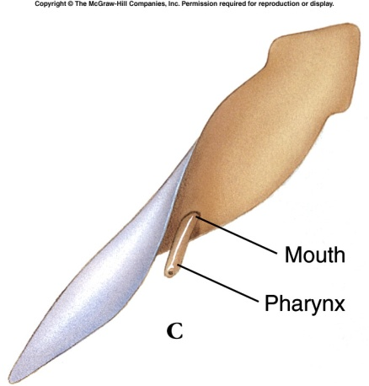
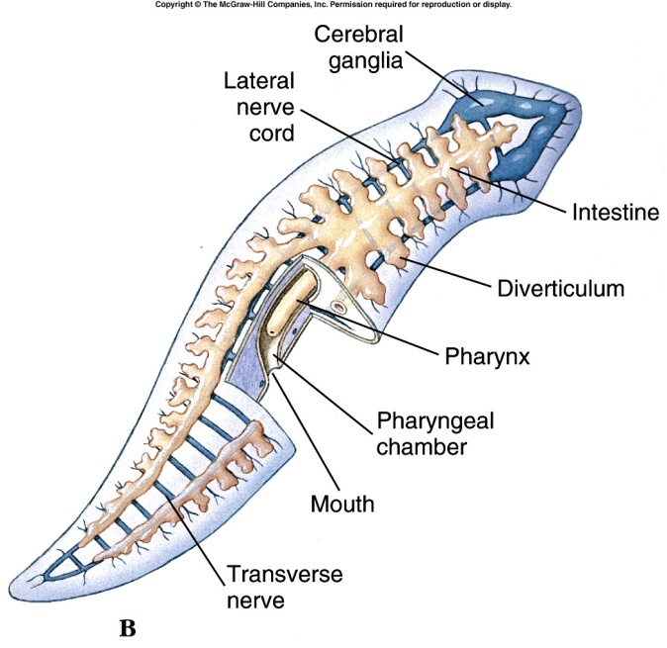
    Nutrition and Digestion
      In planarians, the pharynx can extend through
      the mouth that is mid-ventrally located.
      The intestine has three branches, one anterior
      and two posterior.
      C. This gastrovascular cavity is lined with columnar
      epithelium.
      D. The mouth of trematodes and monogeneans
      opens near the anterior end; the pharynx is not
      extensible; the intestine ends blindly and varies in
      the degree of branching.

Slide 5
Excretory System in Platyhelminthes
The excretory system of flatworms consists of a complex network of cells called flame cells connected to canals and tubes.
Flame cells (aka protonephridia) are beat, kidneys in larger more complex animals (such as the vertebrates).
The flame cells consist of a hollow cup filled with cilia that beat, and pump water and nitrogen waste out the body.
When the cilia of the flame's cells beat, they resemble flames.

Slide 6
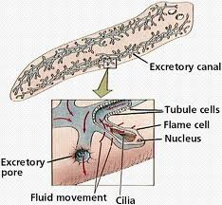
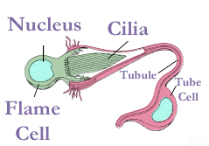
Flame Cells (Protonephridia)

Slide 7
Nervous System of Flatworms
Flatworms are the first animal we have discussed in this class that exhibits cephalization.
Cephalization means they have a head (anterior) and tail (posterior) region and a brain.
Cephalization allows animals to move (crawl, swim, fly etc.) in a certain direction to search for resources.
The central nervous system in flatworms is a region of nerve tissue at the anterior end called a ganglion.
The ganglion attaches to a pair of ventral nerve cords that run the full length of the body.
The nerve cords are sensitive to touch, chemical detection, balance (equilibrium), water current direction and they can control muscular movement.

Slide 8
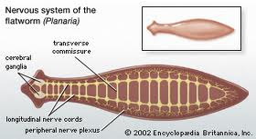
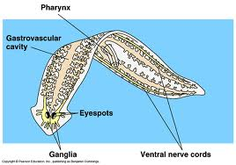
Nervous System of Flatworms
The ganglia are also attached to eye spots that are sensitive to light (but they can not form images).

Slide 9
Reproduction of Flatworms
Flatworms reproduce both sexually and asexually.
Sexual reproduction usually occurs by cross fertilization (exchanging sperm) with other hermaphrodites.
Most flatworms are monoecious. (both male and female)
Only a few flatworms are dioecious (separate sexes).
Asexual reproduction occurs by fission.

Slide 10
Classification of Platyhelminthes
Phylum platyhelminthes contains about 20,000 species
The phylum embraces four classes of worms:
Three are entirely parasitic and include the Trematoda,
Monogenea, and the Cestoda (tapeworms).
The fourth class, the Turbellaria, is free-living and is certainly
the group from which arose the ancestors of the three
parasitic classes.

Slide 11
Class Turbellaria
The body of a turbellarian is covered by a simple ciliated epidermis in which each cell bears many cilia.
The swirling motion of microscopic particles close to the ciliated surface of free-living flatworms is responsible for the name Turbellaria, which means “whirlpool”.
Thus, turbellarians are named for the turbulence that their beating cilia create in the water. Turbellarians are free living; primarily aquatic, and the great majority are marine few pelagic species, most are bottom dwellers that live in sand or mud.
Freshwater turbellarians live in lakes, ponds, streams, and springs, where they occupy benthic habitats, some species have become terrestrial, but these are confined to humid areas and usually hide beneath logs and leaf mold during day, emerging only at night to feed.
About 3,000 species of turbellarians have been described.
Range in size from microscopic to extremely large (two feet).

Slide 12
Class Turbellaria
Mouth located on ventral surface near the center of the body.
Mostly hermaphroditic.
Some can reproduce asexually by fission.
Examples: Dugesia (planaria), Microstomum, Planocera.
Nutrition
Turbellarians are carnivores and prey on other animals or eat dead animal
remains.
Planarians have a muscular pharynx that they can insert into their prey and
then pump to bring in food fragments.
These animals have a highly divided gut to greatly increase the surface area for
digestion and absorption.

Slide 13
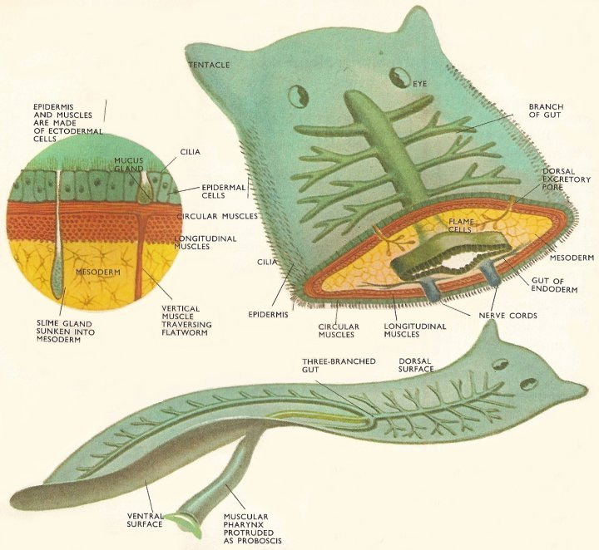
Digestive System of Turbellarians

Slide 14
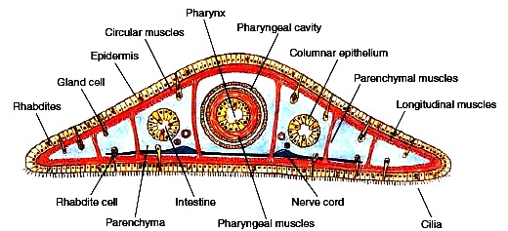
C.S.in Planaria body

Slide 15
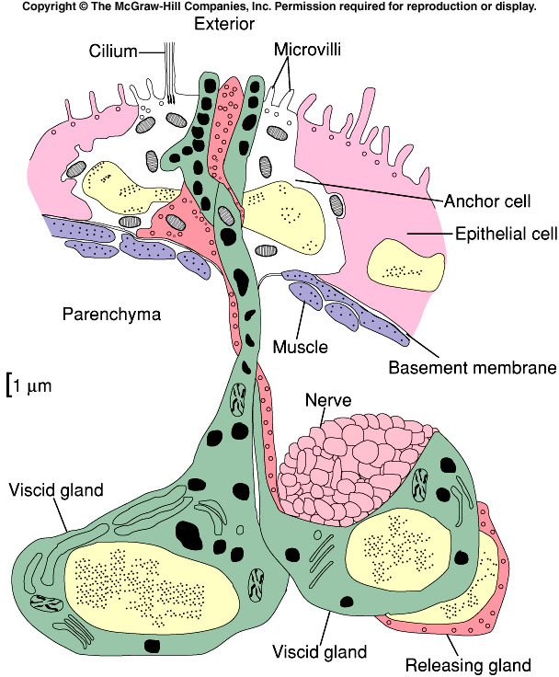
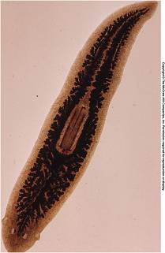

Slide 16
Form and Function
    1. Tegument and Muscles
      a. Most turbellarians have a cellular, ciliated epidermis on a basement membrane.
      b. Rod-shaped rhabditids swell and form a protective mucous sheaths. Most turbellarians have dual-gland adhesive organs
        1) Viscid gland cells fasten microvilli of anchor cells to the substrate.
        2) Secretions of releasing gland cells provide a quick chemical detachment.
      c. Under the basement membrane, muscle fibers run circularly, longitudinally and diagonally.

Slide 17
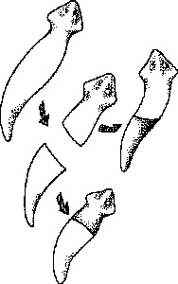
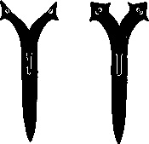
Reproduction in Turbellarians
Planarians are capable of both sexual and asexual reproduction.
Capable of regeneration; exhibit both anterior-
posterior and lateral polarity.
They are hermaphrodites but usually exhibit
cross-fertilization.
The penis of some turbellarians is modified as a
hollow stylet; sperm transfer is by hypodermic
impregnation, in which the copulating partners
stab each other and inject sperm.

Slide 18
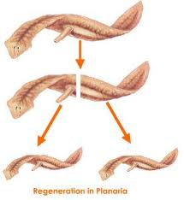
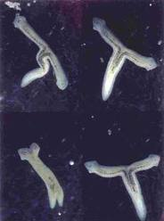
Regeneration of a Planarian Flatworm

Slide 19
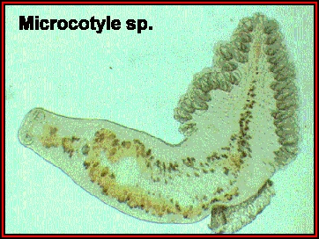
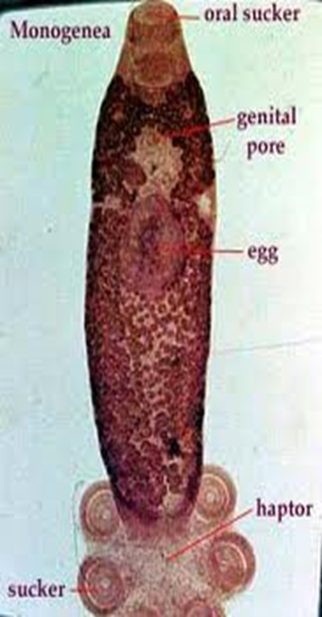
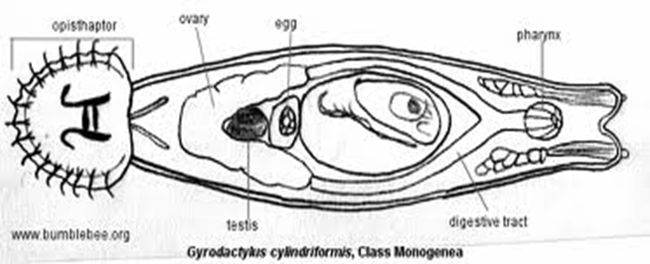
Class Monogenea
~ 400 spp.
mostly ectoparasites of fish, amphibians.
Feed on blood, mucus..
Anterior and posterior ends for clinging, but life cycle remains simple, with a single free living larval stage
haptors
P
A

Slide 20
Class Monogenea; Monogenetic Flukes
Ectoparasites that attach to the gills of fish.
Hook-like mouth called an opisthaptor.
They can become a serious threat when fish become crowded, like in the case of fish farming.
Life cycle simple with only a single host
Examples: Dactylogyrus, Polystoma, Gyrodactylus

Slide 21
Class Trematoda (Flukes)
The class Trematoda includes two subclasses:
Subclass Aspidogastrea
Subclass Digenea
Subclass Aspidogastrea is a small group of flukes that are primarily internal parasites (endoparasites) of molluscs.
A large, oval holdfast organ called the opisthaptor covers the entire ventral surface of the animal and characterizes all aspidogastreans.
The life cycle of aspidogastreans may involve only one host (a mollusks) or two hosts. In the latter case, the final host is usually a vertebrate (fishes or turtles) that becomes infected by ingesting a mollusks that contains immature aspidogastreans.

